Slide 1

Student DetAils:
Name : Harshavardhan Panguluri
SkillBuild Email ID : harshavardhanpanguluri04@gmail.com
AICTE Email ID : harshavardhanpanguluri04@gmail.com
Organization: DGT
College Name : Sri Venkateswara College Of Engineering
& Technology(Autonomous),Chittoor
College State : Andhrapradesh
Internship Domain : Data Analytics
Start Date & End Date : 12 – 06 - 2023 to 24 – 07 - 2023

Slide 2

PROJECT TITLE:
CASE STUDY: ANALYSIS OF SUPERSTORE DATASET
Introduction:
The goal of this project is to conduct a comprehensive analysis of the Sample
Superstore dataset to gain valuable insights into Sales trends and Profitability of the store.
•
Sales Analysis: Analyze sales metrics, trends, and factors influencing sales fluctuations.
•
Profit Analysis: Analyze the profit and factors affecting profit of various items in the store.
The Superstore dataset encompasses a wide range of information, including sales data, customer
demographics, product categories, and geographical regions. By leveraging this dataset, our objective is to
identify areas for improvement and provide data-driven recommendations to optimize the performance of the
store. The purpose of this report is to present our findings and recommendations based on the analysis of this
dataset.

Slide 3

AGENDA
➢
Introduction to the Project- Analysis of Superstore Dataset
➢
Project Overview- Purpose, Scope and Objective
➢
End Users
➢
Solution and Value Proposition
➢
Customization of the Project & Code Snippets
➢
Modelling & Insights
➢
Results of Analysis – Key Insights, Actionable Insights, Customized Solutions
➢
Relevant Links

Slide 4
PROJECT OVERVIEW
PURPOSE:
The purpose of the project is to perform Descriptive Data Analysis on Superstore data to gather relevant
insights regarding sales and profit of the superstore-
➢
Extract, Transform and Load (ETL) the data
➢
Perform Exploratory Data Analysis (EDA) on the dataset
SCOPE:
The project focused on understanding sales trends and profitability across regions, cities, categories, and sub-
categories within the Superstore dataset.
➢
Goal:
❖
Perform Descriptive Analysis of the ‘SampleSuperstore’ Dataset using Python
❖
Highlight the insights regarding Sales and Profit of the Superstore as gathered from analysing the data.
➢
Tools Used: Python and libraries- Numpy, Pandas, Matplotlib and Seaborn

Slide 5
PROJECT OVERVIEW
OBJECTIVES:
➢
Understand, clean and visualize the dataset to gain insights from the data
➢
Analyze the Sales and Profit based on different regions, categories and other parameters, that is-
❖
Analyze sales patterns in different regions and cities to identify the highest-selling areas.
❖
Determine the top-selling categories and sub-categories within the Superstore dataset.
❖
Assess the profitability of different products and identify the most profitable areas.
❖
Find the Cities, States and Regions having maximum Profit and maximum Sales.
➢
Provide data-driven insights and recommendations for optimizing sales and improving profitability.

Slide 6
END USERS
➢
Store managers and executives: The insights from the analysis can guide data-driven decision-
making and strategic planning to optimize store operations.
➢
Sales and marketing teams: The analysis provides valuable information for designing effective
sales and marketing strategies based on customer demographics, preferences and buying patterns to
develop targeted marketing campaigns and improve customer engagement.
➢
Financial analysts and stakeholders: The analysis offers insights into profit margins and can
enhance financial decision-making for stakeholders of the superstore.

Slide 7
SOLUTION AND ITS VALUE PROPOSITION
Solution: The project involved a comprehensive analysis of the Superstore dataset to gain insights into
sales trends and profitability of the Superstore. This analysis utilized various Python libraries like NumPy,
Pandas, statistical and data mining techniques and visualization tools such as Matplotlib and Seaborn to
efficiently analyze the Superstore dataset.
Value Proposition: The analysis provides data-driven recommendations for decision making to -
➢
optimize sales,
➢
improve profitability, and
➢
inform business strategies for personalized marketing.
The use of Python libraries and visualization tools enhances the efficiency and effectiveness of the
analysis by making it easily interpretable.

Slide 8
CUSTOMIZATION OF PROJECT & CODE SNIPPETS
➢
The analysis was tailored to the specific requirements of the Superstore dataset.
➢
Use of advanced Visualization Tools:
In this project, I have used advanced visualization libraries like Matplotlib and Seaborn to emphasize
on the uniqueness of my solution by presenting it in a visually appealing manner such that it provides
clear understanding of the insights to the end users.
➢
Descriptive Analysis & EDA:
This project also utilizes the various techniques of Descriptive Analytics and Exploratory Data
Analysis to summarize and present the key insights regarding Sales and Profit of the Superstore.

Slide 9
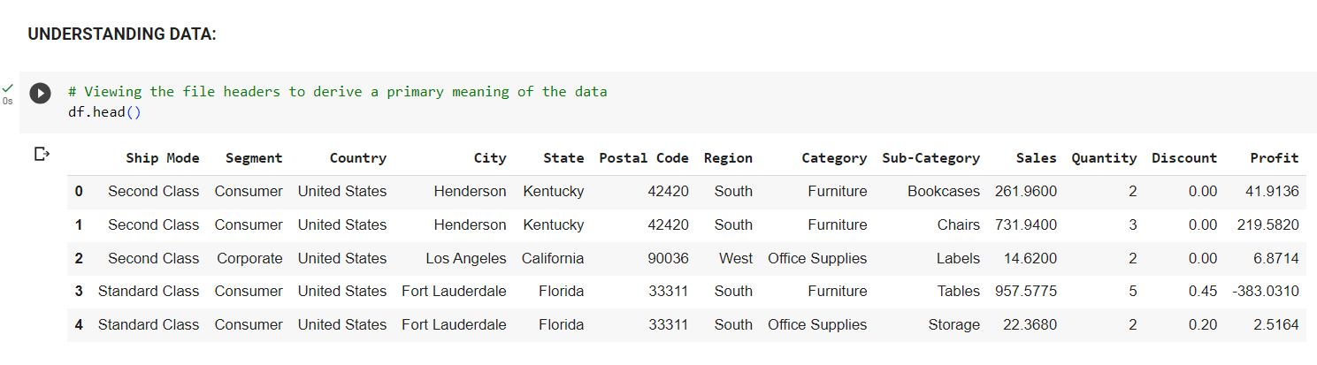
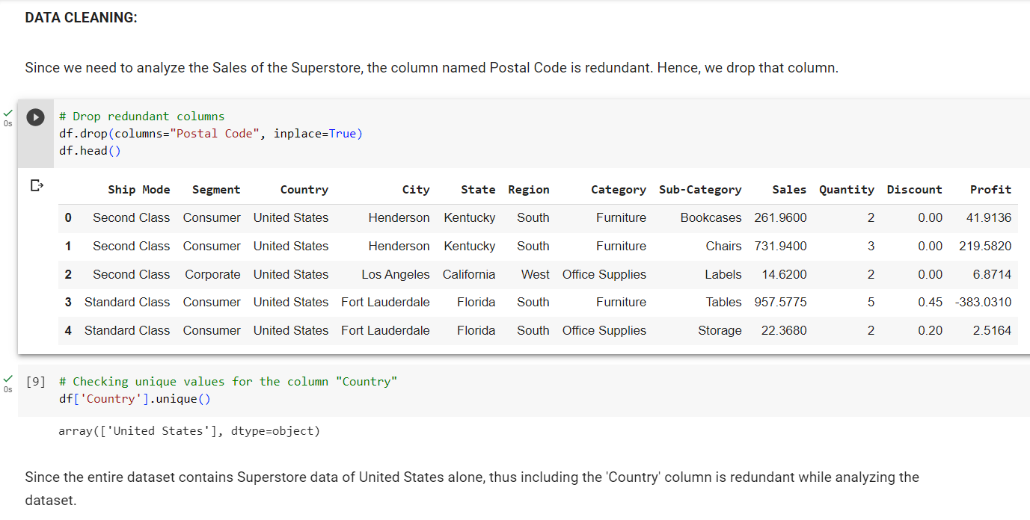
CUSTOMIZATION OF PROJECT & CODE SNIPPETS
Code Snippets: Here are a few
code snippets from the project to
demonstrate the data loading,
cleaning, and transformation
processes. These snippets
showcases the use of Python
libraries such as Pandas, NumPy,
and Matplotlib for data
manipulation and visualization in
this project.

Slide 10
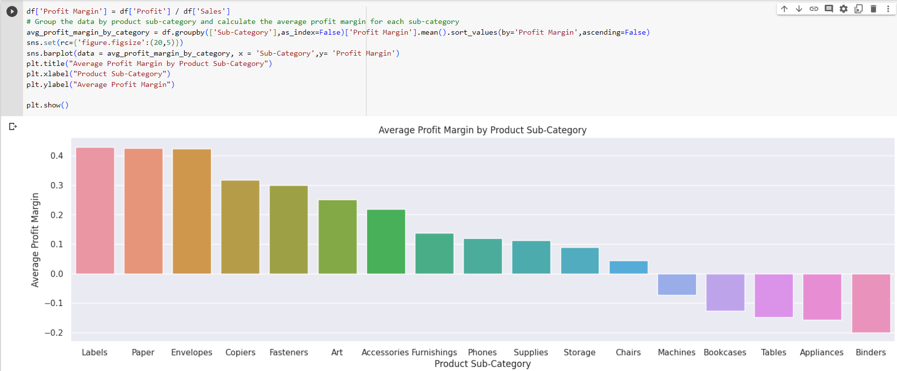
CUSTOMIZATION OF PROJECT & CODE SNIPPETS
DATA TRANSFORMATION:

Slide 11
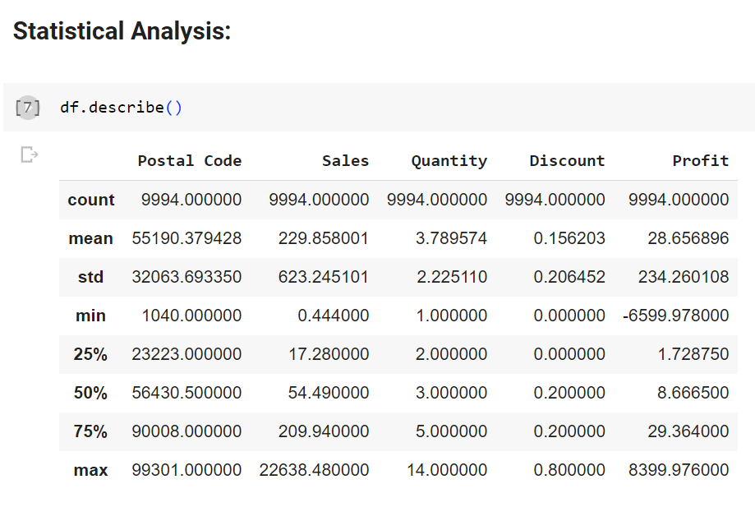
MODELLING AND INSIGHTS
The modelling techniques used for data analysis in this project are –
➢
Statistical Analysis:
Used to discover correlations, trends, and
patterns within the Superstore dataset.
These techniques helped in understanding
the impact of various factors on Sales and
Profitability.

Slide 12
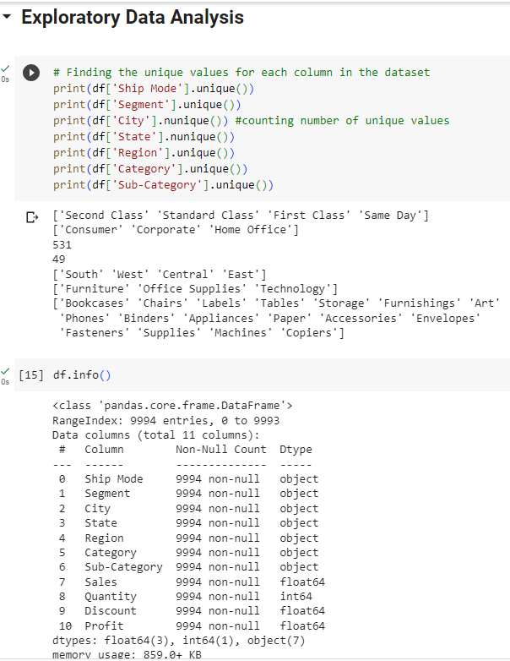
MODELLING AND INSIGHTS
➢
Exploratory Data Analysis (EDA):
EDA techniques were employed to gain
initial insights into the dataset. This included
data visualization through charts, graphs, and
plots to understand the distribution of
variables, identify outliers, and detect
patterns or relationships between different
variables.

Slide 13
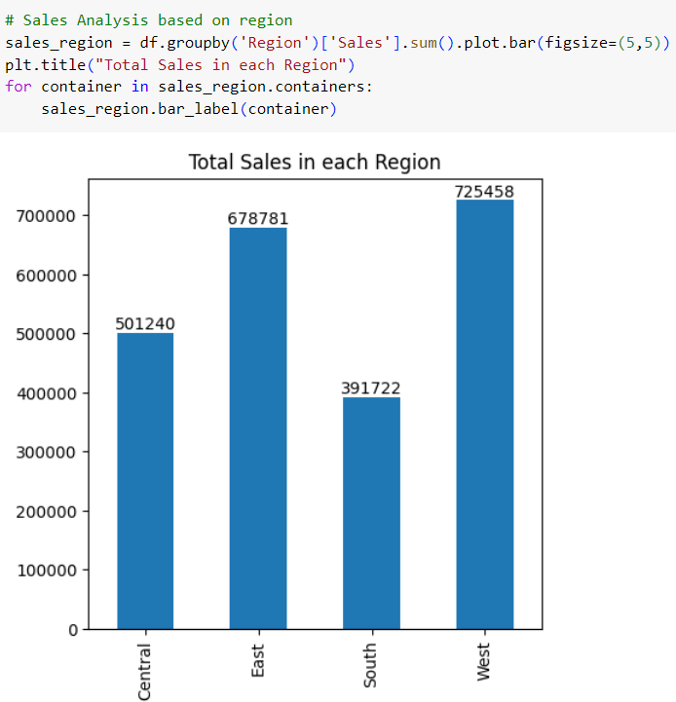
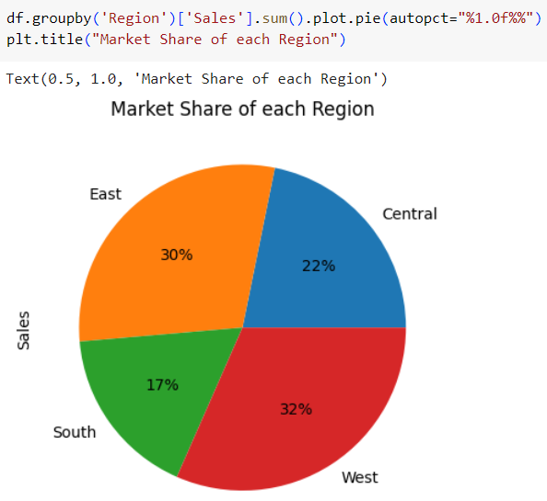
MODELLING AND INSIGHTS
➢
Exploratory Data Analysis (EDA):
This comprises mainly two basis of analysis –
❖
Sales Analysis:

Slide 14
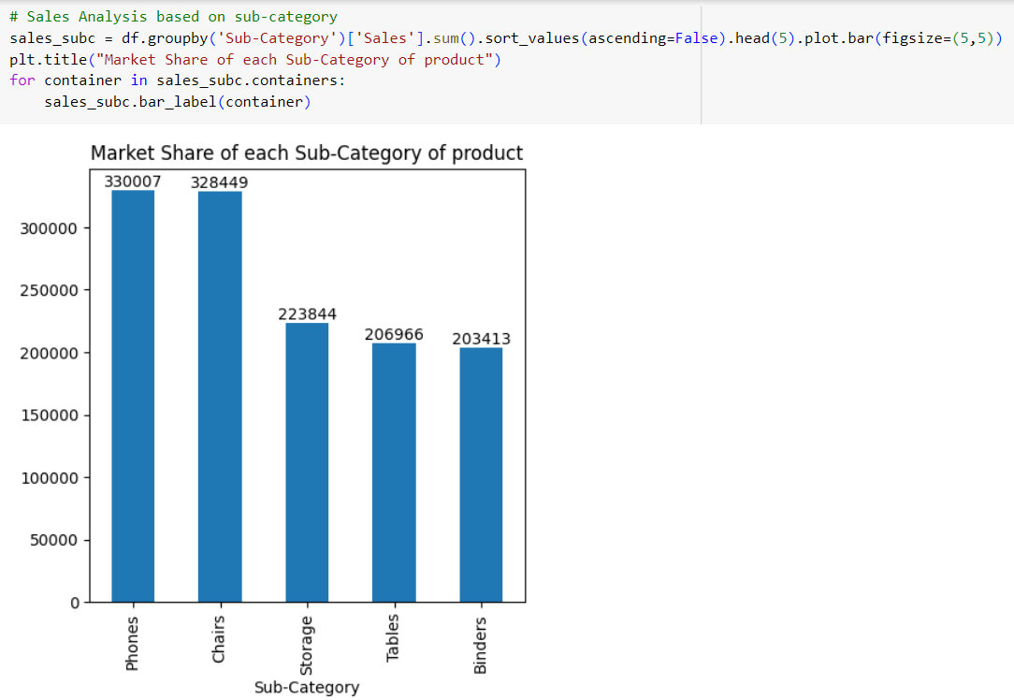
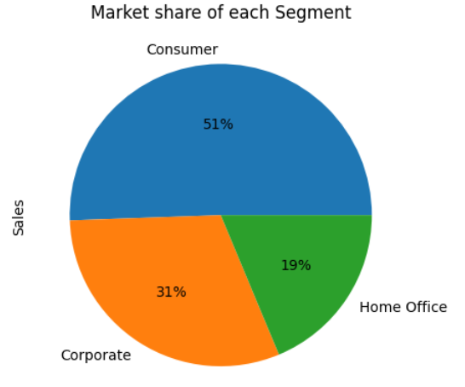
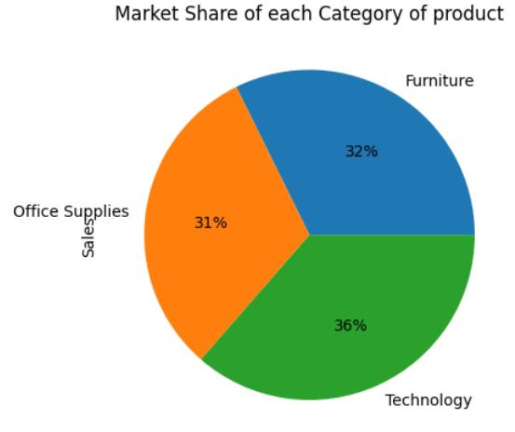
MODELLING AND INSIGHTS
➢
Exploratory Data Analysis (EDA):
❖
Sales Analysis:

Slide 15
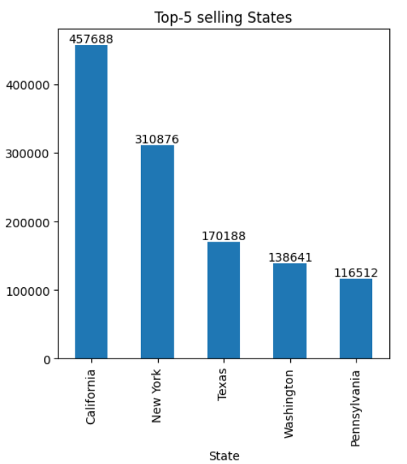
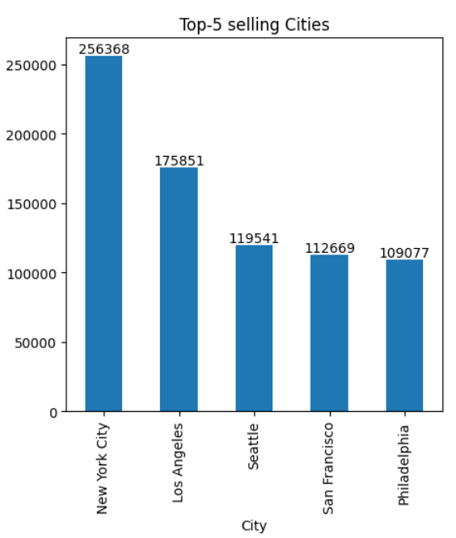
MODELLING AND INSIGHTS
➢
Exploratory Data Analysis (EDA):
❖
Sales Analysis:

Slide 16
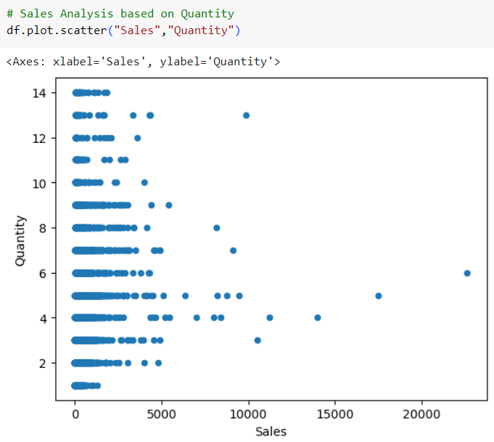
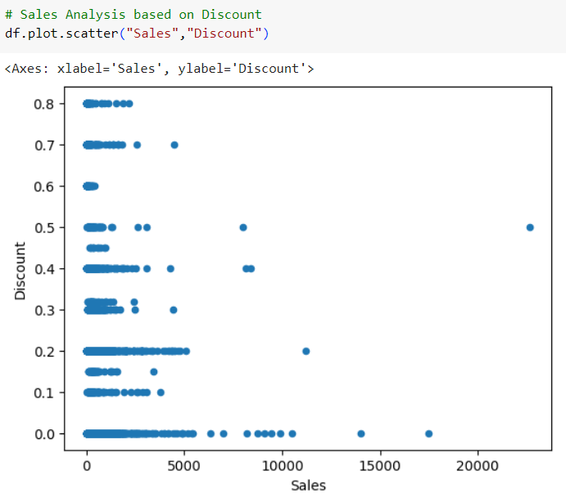
MODELLING AND INSIGHTS
➢
Exploratory Data Analysis (EDA):
❖
Sales Analysis:

Slide 17
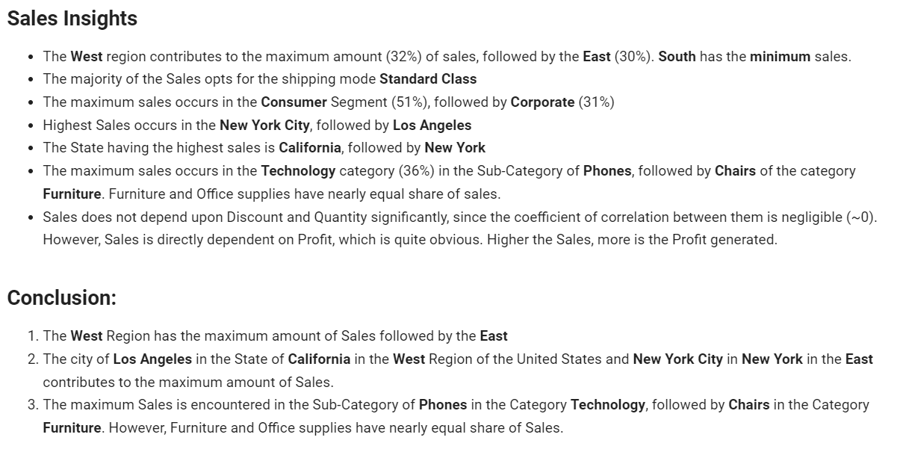
MODELLING AND INSIGHTS
➢
Exploratory Data Analysis (EDA):
❖
Sales Analysis Insights:

Slide 18
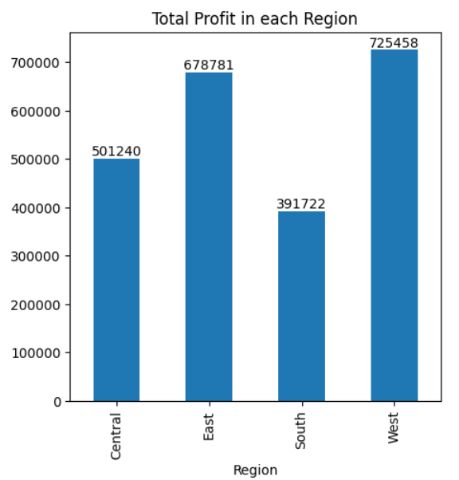
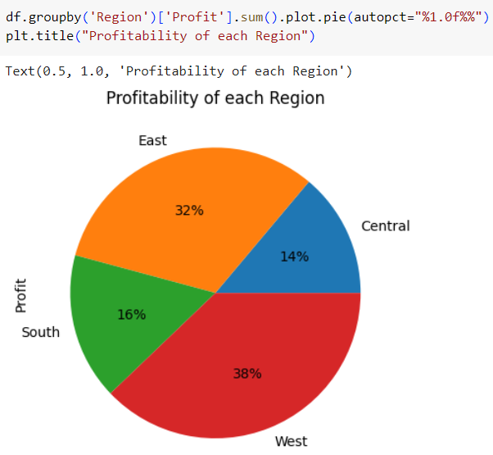
MODELLING AND INSIGHTS
➢
Exploratory Data Analysis (EDA):
This comprises of mainly two basis of analysis –
❖
Profit Analysis:

Slide 19
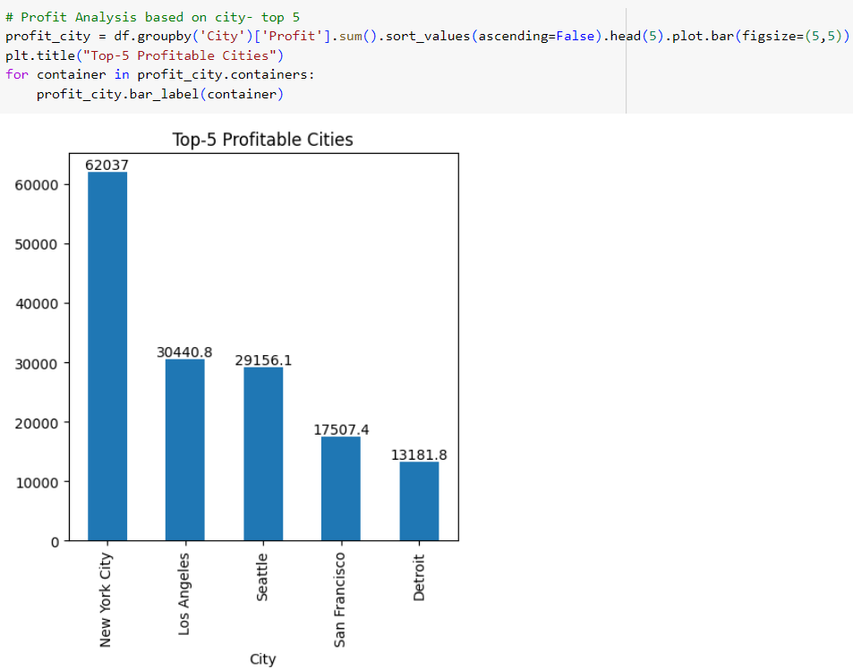
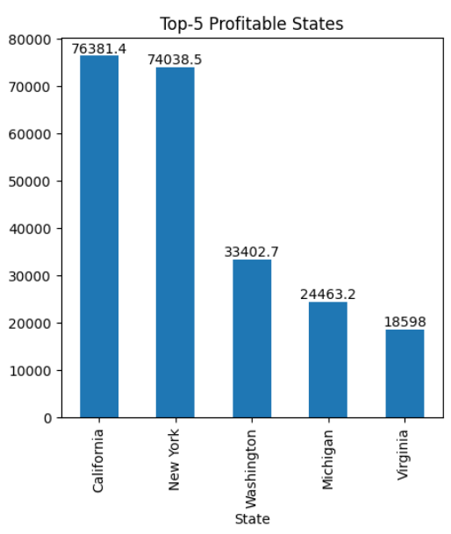
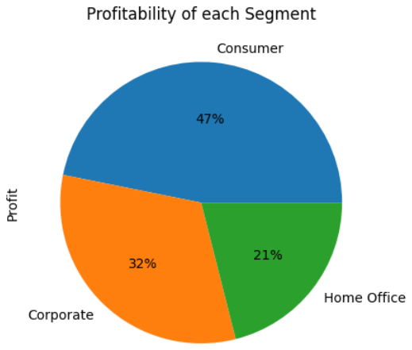
MODELLING AND INSIGHTS
➢
Exploratory Data Analysis
(EDA):
This comprises of mainly two basis
of analysis –
❖
Profit Analysis:

Slide 20
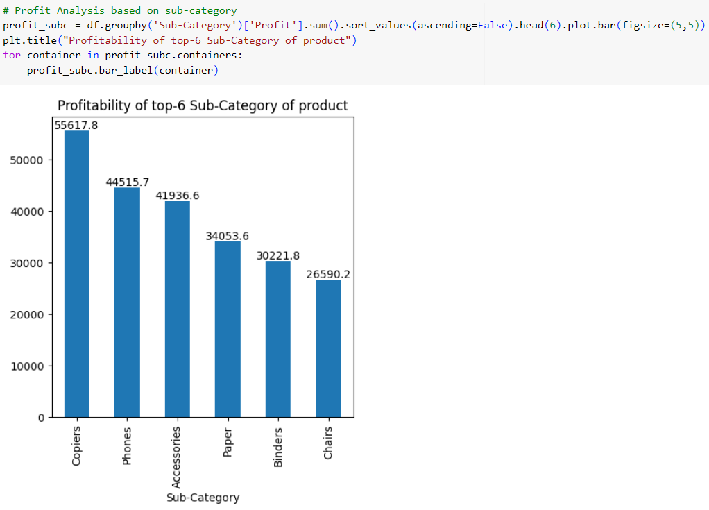
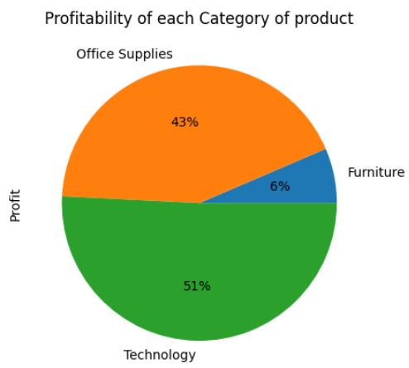
MODELLING AND INSIGHTS
➢
Exploratory Data Analysis (EDA):
This comprises of mainly two basis of
analysis –
❖
Profit Analysis:

Slide 21
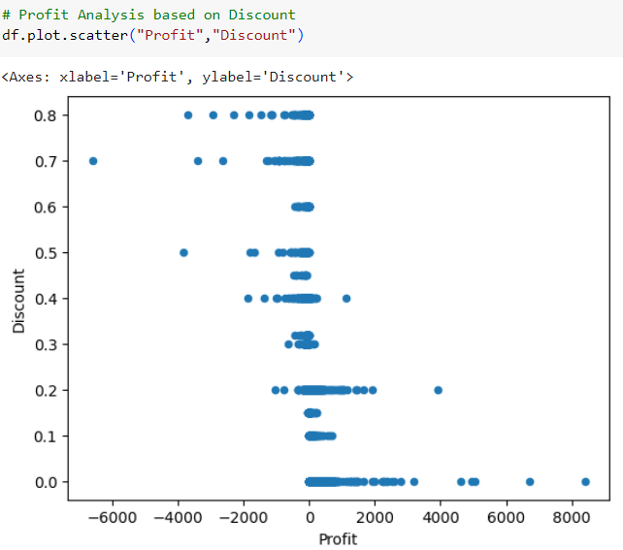
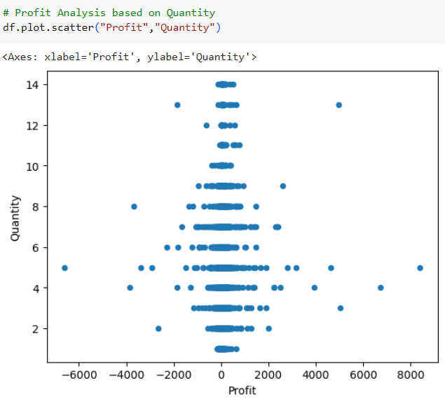
MODELLING AND INSIGHTS
➢
Exploratory Data Analysis (EDA):
This comprises of mainly two basis of analysis –
❖
Profit Analysis:

Slide 22
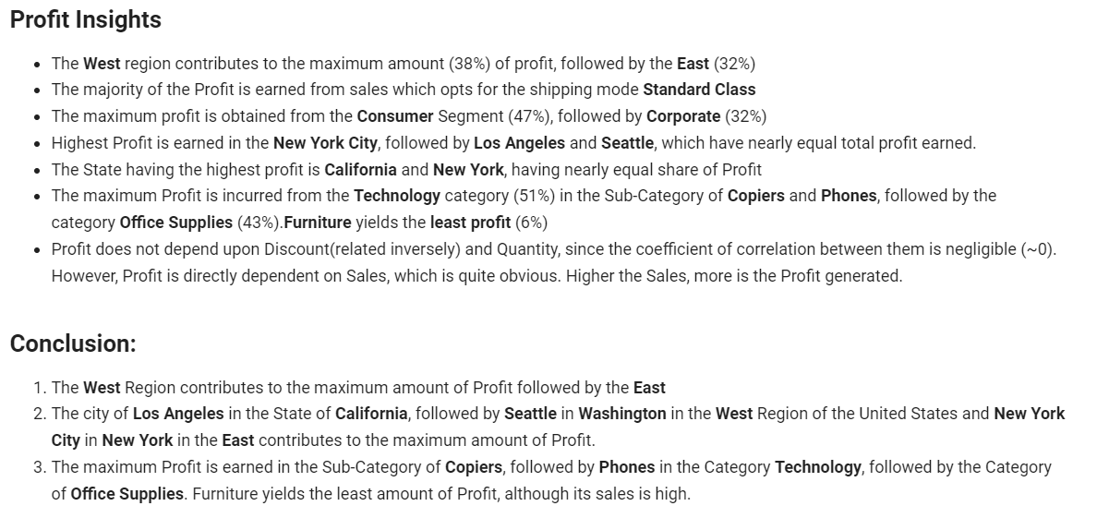
MODELLING AND INSIGHTS
➢
Exploratory Data Analysis (EDA):
❖
Profit Analysis Insights:

Slide 23
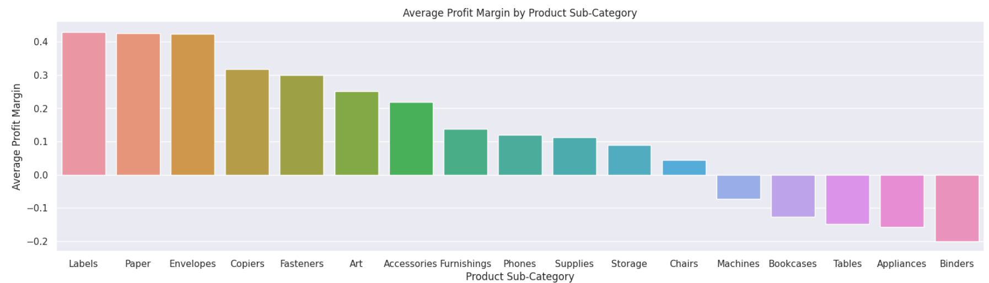
MODELLING AND INSIGHTS
➢
Data Visualization:
Advanced data visualization techniques using tools like Python libraries (e.g., Matplotlib, Seaborn) were
used to create visually appealing and informative charts and graphs. These visualizations facilitated the
effective interpretation of the analysis results and provided a clear understanding of key findings.

Slide 24
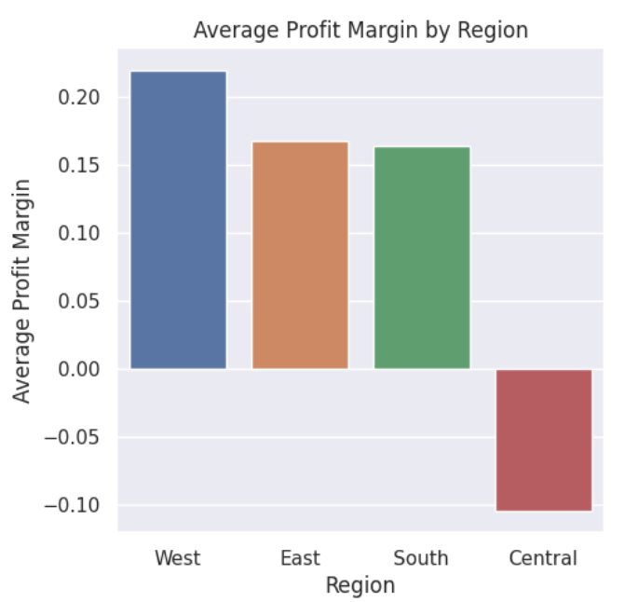
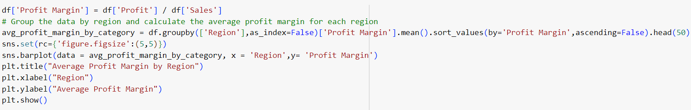
MODELLING AND INSIGHTS
These modelling techniques formed the
pillars of the Project – Analysis of
Superstore Dataset for Data Analytics,
ensuring a systematic and data-driven
approach to extract valuable insights from
the dataset.

Slide 25
RESULTS OF ANALYSIS
➢
Key Insights: The key findings of the Sales and Profit Analysis are summarized, including the highest-
selling regions, cities, and sub-categories, as well as the most profitable areas –
❖
Sale of products in the Technology Category results in Maximum Profit Margin, more
specifically Copiers, Fasteners, Accessories and Phones, followed by Office Supplies including Labels,
Papers and Envelopes. Chairs are the only product in the Furniture Category which is profitable, other
products of this category results in Loss
❖
The Segment- Home Office is the most profitable, followed by Corporate
❖
Sales in the West Region has the Highest Profitability, followed by the East while that in
the Central Region suffers the Highest Loss

Slide 26
RESULTS OF ANALYSIS
➢
Actionable Insights: Actionable insights derived from the analysis are presented, highlighting the
areas where optimization opportunities exists for sales improvement and profitability enhancement –
❖
To ensure Maximum Profit, the production in the Technology Sector must be upgraded so that the
products mentioned above are available to the customers in required quantity so as to always remain
ahead of the Market Demand.
❖
Suitable actions must be taken ensure Profit in the Furniture Category for products other than Chairs
or else the cost of production of those commodities must be reduced.
❖
More products of the Segment- Home Office must be produced so as to ensure abundant supply and
maximum profit of the Superstore.
❖
The Sales in the Central Region of the United States must be inspected for the cause of overall Loss
and suitable steps must be taken to rectify the same to ensure Profit.

Slide 27
RESULTS OF ANALYSIS
➢
Customized Solutions: The presentation emphasizes on the significance of customized solutions
based on data-driven analysis to achieve better business outcomes –
❖
The city of Los Angeles in the State of California in the West Region of the United States and New
York City in New York in the East contributes to the maximum amount of Sales. Thus, proper
infrastructure, machinery and production must be especially ensured in the Superstore in these cities to
facilitate higher Sales of Profit-earning commodities.
❖
The city of Los Angeles in the State of California, followed by Seattle in Washington in
the West Region of the United States and New York City in New York in the East contributes to the
maximum amount of Profit. Thus, higher production must be ensured for the Superstores in these
areas so as to ensure Maximum Profit from the sale of products here.

Slide 28
RELEVANT LINKS
➢
GitHub Repository Link:
https://github.com/harsha86604/Edunet-Foundation-DataAnalytics-Internship
➢
Dataset Link:
https://www.kaggle.com/datasets/bravehart101/sample-supermarket-dataset
➢
Source Code (Google Colab):
https://colab.research.google.com/drive/1dWO6_rQTF-_S2s-94VW3UKpwP4r_EQha?usp=sharing
➢
Googl Drive link for Source Code and Project Submission PPT:
https://drive.google.com/drive/folders/1xstX6qXg8apgoGOyADDykQgDohbaCue4?usp=sharing

Slide 29
THANK YOU
IBM SKILLBUILD
EDUNET FOUNDATION

